Slide 1
Chapter 5: Describing Quantitative Data
Textbook: Ahmad Daryanto, Introduction to Quantitative Research Methods for Marketing With SPSS and R: Tools and Techniques, Routledge. 2024

Slide 2
Learning Objectives
Understand measures of central tendency: mean, mode, median.
Understand measures of central dispersion: variance, standard deviation, range, interquartile range (IQR).
Know how to construct a histogram and a boxplot using SPSS and R.
Understand the use of a boxplot.

Slide 3
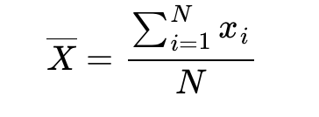
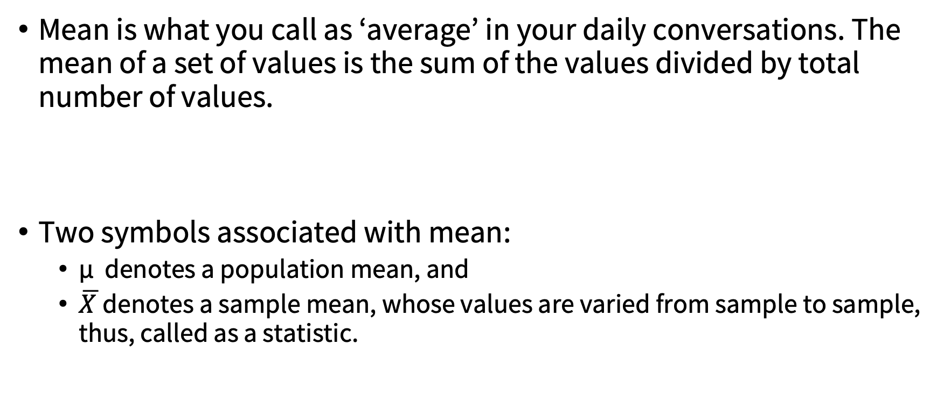
Mean
Mean is what you call as ‘average’ in your daily conversations. The mean of a set of values is the sum of the values divided by total number of values.
Two symbols associated with mean:
μ denotes a population mean, and
$\overline{X }$denotes a sample mean, whose values are varied from sample to sample, thus, called as a statistic.

Slide 4
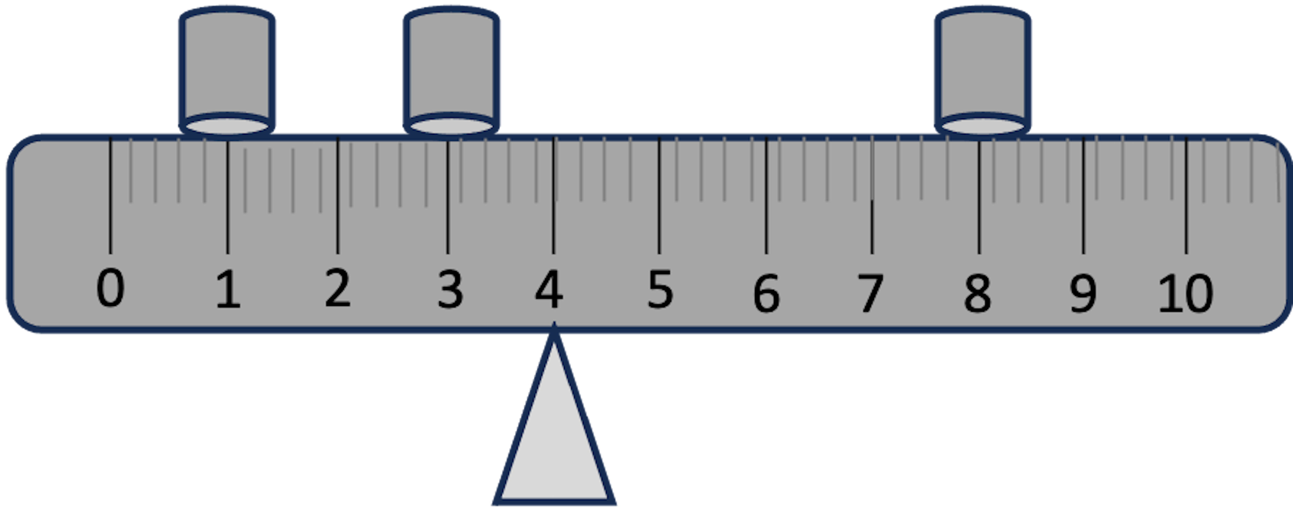
Mean as a balance point. Sum of the distances of each point to the mean is zero

Slide 5
Quartiles
Quartiles are special cases of quantiles that divide set of values into four part of quarters where data is arranged in an increasing order. The lower quartile (Q1) or first quartile is the value under which 25% of data points are found. The upper quartile (Q3) or the third quartile is the value under which 75% of data points.

Slide 6
Quartiles
When the number of values are not even / odd
Example
Number of TV hours watched
4 | 5 | 6 | 7 | 8 | 9 | 10 | 11
Q1 = 5.5
Median = 7.5
Q3 = 9.5
Middle value of the lower half
Middle value of the upper half
IQR stands for the inter-quartile range = Q3 – Q1.
IQR of the above data is 9.5 – 5.5 = 4

Slide 7
Median
Every quantitative data has a median. Median is preferable if data contains unusual values (e.g., extremely high values) or if the distribution of data is skewed because median is not affected by the presence of these unusual values

Slide 8
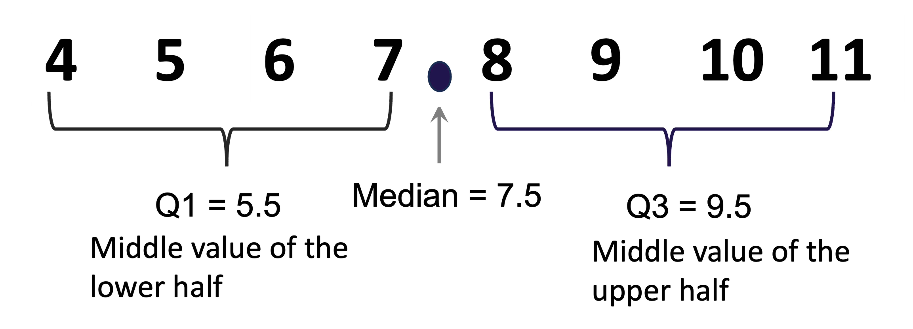

Slide 9
Properties of median
Median is not affected by an extreme value or outliers.
Data 1
4 | 5 | 6 | 7 | 8 | 9 | 10
4 | 5 | 6 | 7 | 8 | 9 | 100
Data 2

Slide 10
Percentiles
Percentiles are terms to locate the position of data values. An X-th percentile is a value below which an X percentage of cases fall. For example, if your exam score is in the 90th percentile, this means that you are better than 90% of students in your cohort (10 percent of them scored higher than yours). The 25th percentile is called the lower quartile (Q1), the 75th percentile is called the upper quartile (Q3), and the 50th percentile is called the median.
While percentile is defined in terms of a percentage, quantile is defined in terms of a decimal. For example, the 25th or 25% percentile is the same as 0.25 quantile. Quartile is a special case of quantile (lower quartile, middle quartile, and upper quartile).

Slide 11
SPSS Action
Calculating the 25th (Q1), 50th (Q2), and 75th (Q3) percentile.
FREQUENCIES VARIABLES=value
/PERCENTILES=25.0 50.0 75.0
/ORDER=ANALYSIS.
The method implemented by the `Frequencies` procedure in SPSS is not the same as the manual calculation because the data is considered as a sample and the procedure ensures that it is the unbiased estimate of the population percentile.

Slide 12
R Action
library(haven)
dat <- read_sav("/Users/ahmaddaryanto/Documents/Data1/quantile.sav")
out <- quantile(dat$value)
out

Slide 13
Variance and Standard Deviation
Typically reported in tandem with the mean.
Standard deviation tells us about how data points are spread out.
Standard deviation is the square root of variance.

Slide 14
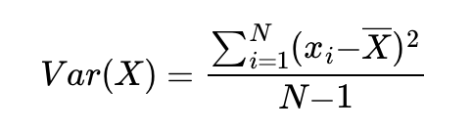
Sample Variance
If you want to calculate the variance of a sample, the numerator that you should use is N−1 not N (see equation below), otherwise you will underestimate the population variance. This is because the sample variance is used to infer the population variance.

Slide 15
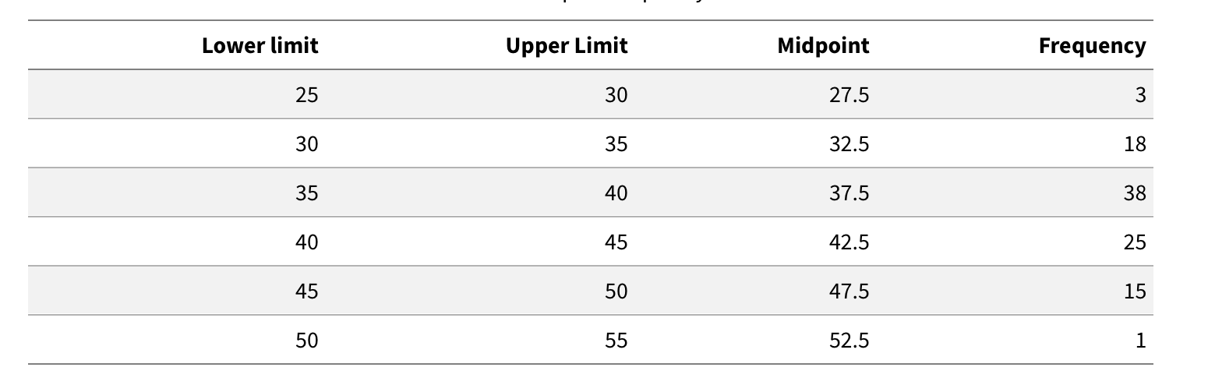
Histogram
It gives an idea how a variable is distributed.
It arises from grouped frequency data.

Slide 16
SPSS Action
GRAPH
/HISTOGRAM=amount.

Slide 17
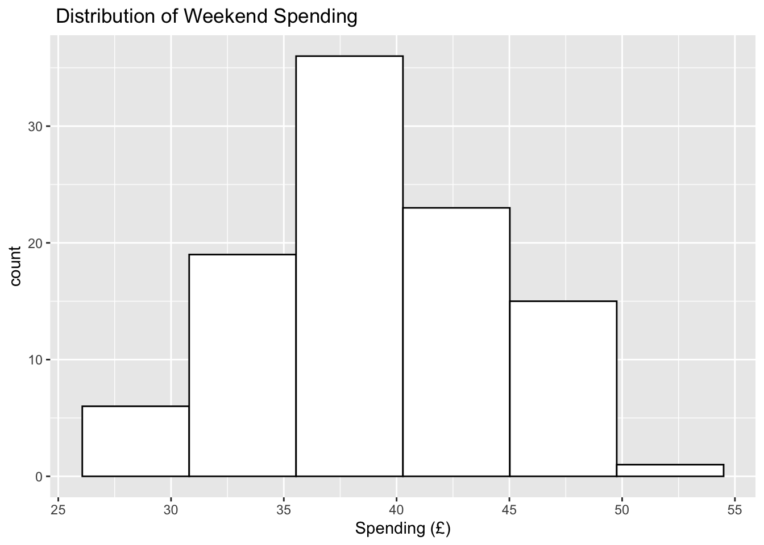
R Action
rm(list = ls(all=TRUE)) # make a fresh start
library(ggplot2)
library(haven)
dat <- read_sav("/Users/ahmaddaryanto/Documents/Data1/spending.sav")
p <- ggplot(dat, aes(amount)) +
geom_histogram(bins = 6,
color="black",
fill="white") +
labs(x="Spending (£)", title = " Distribution of Weekend Spending ")
p

Slide 18
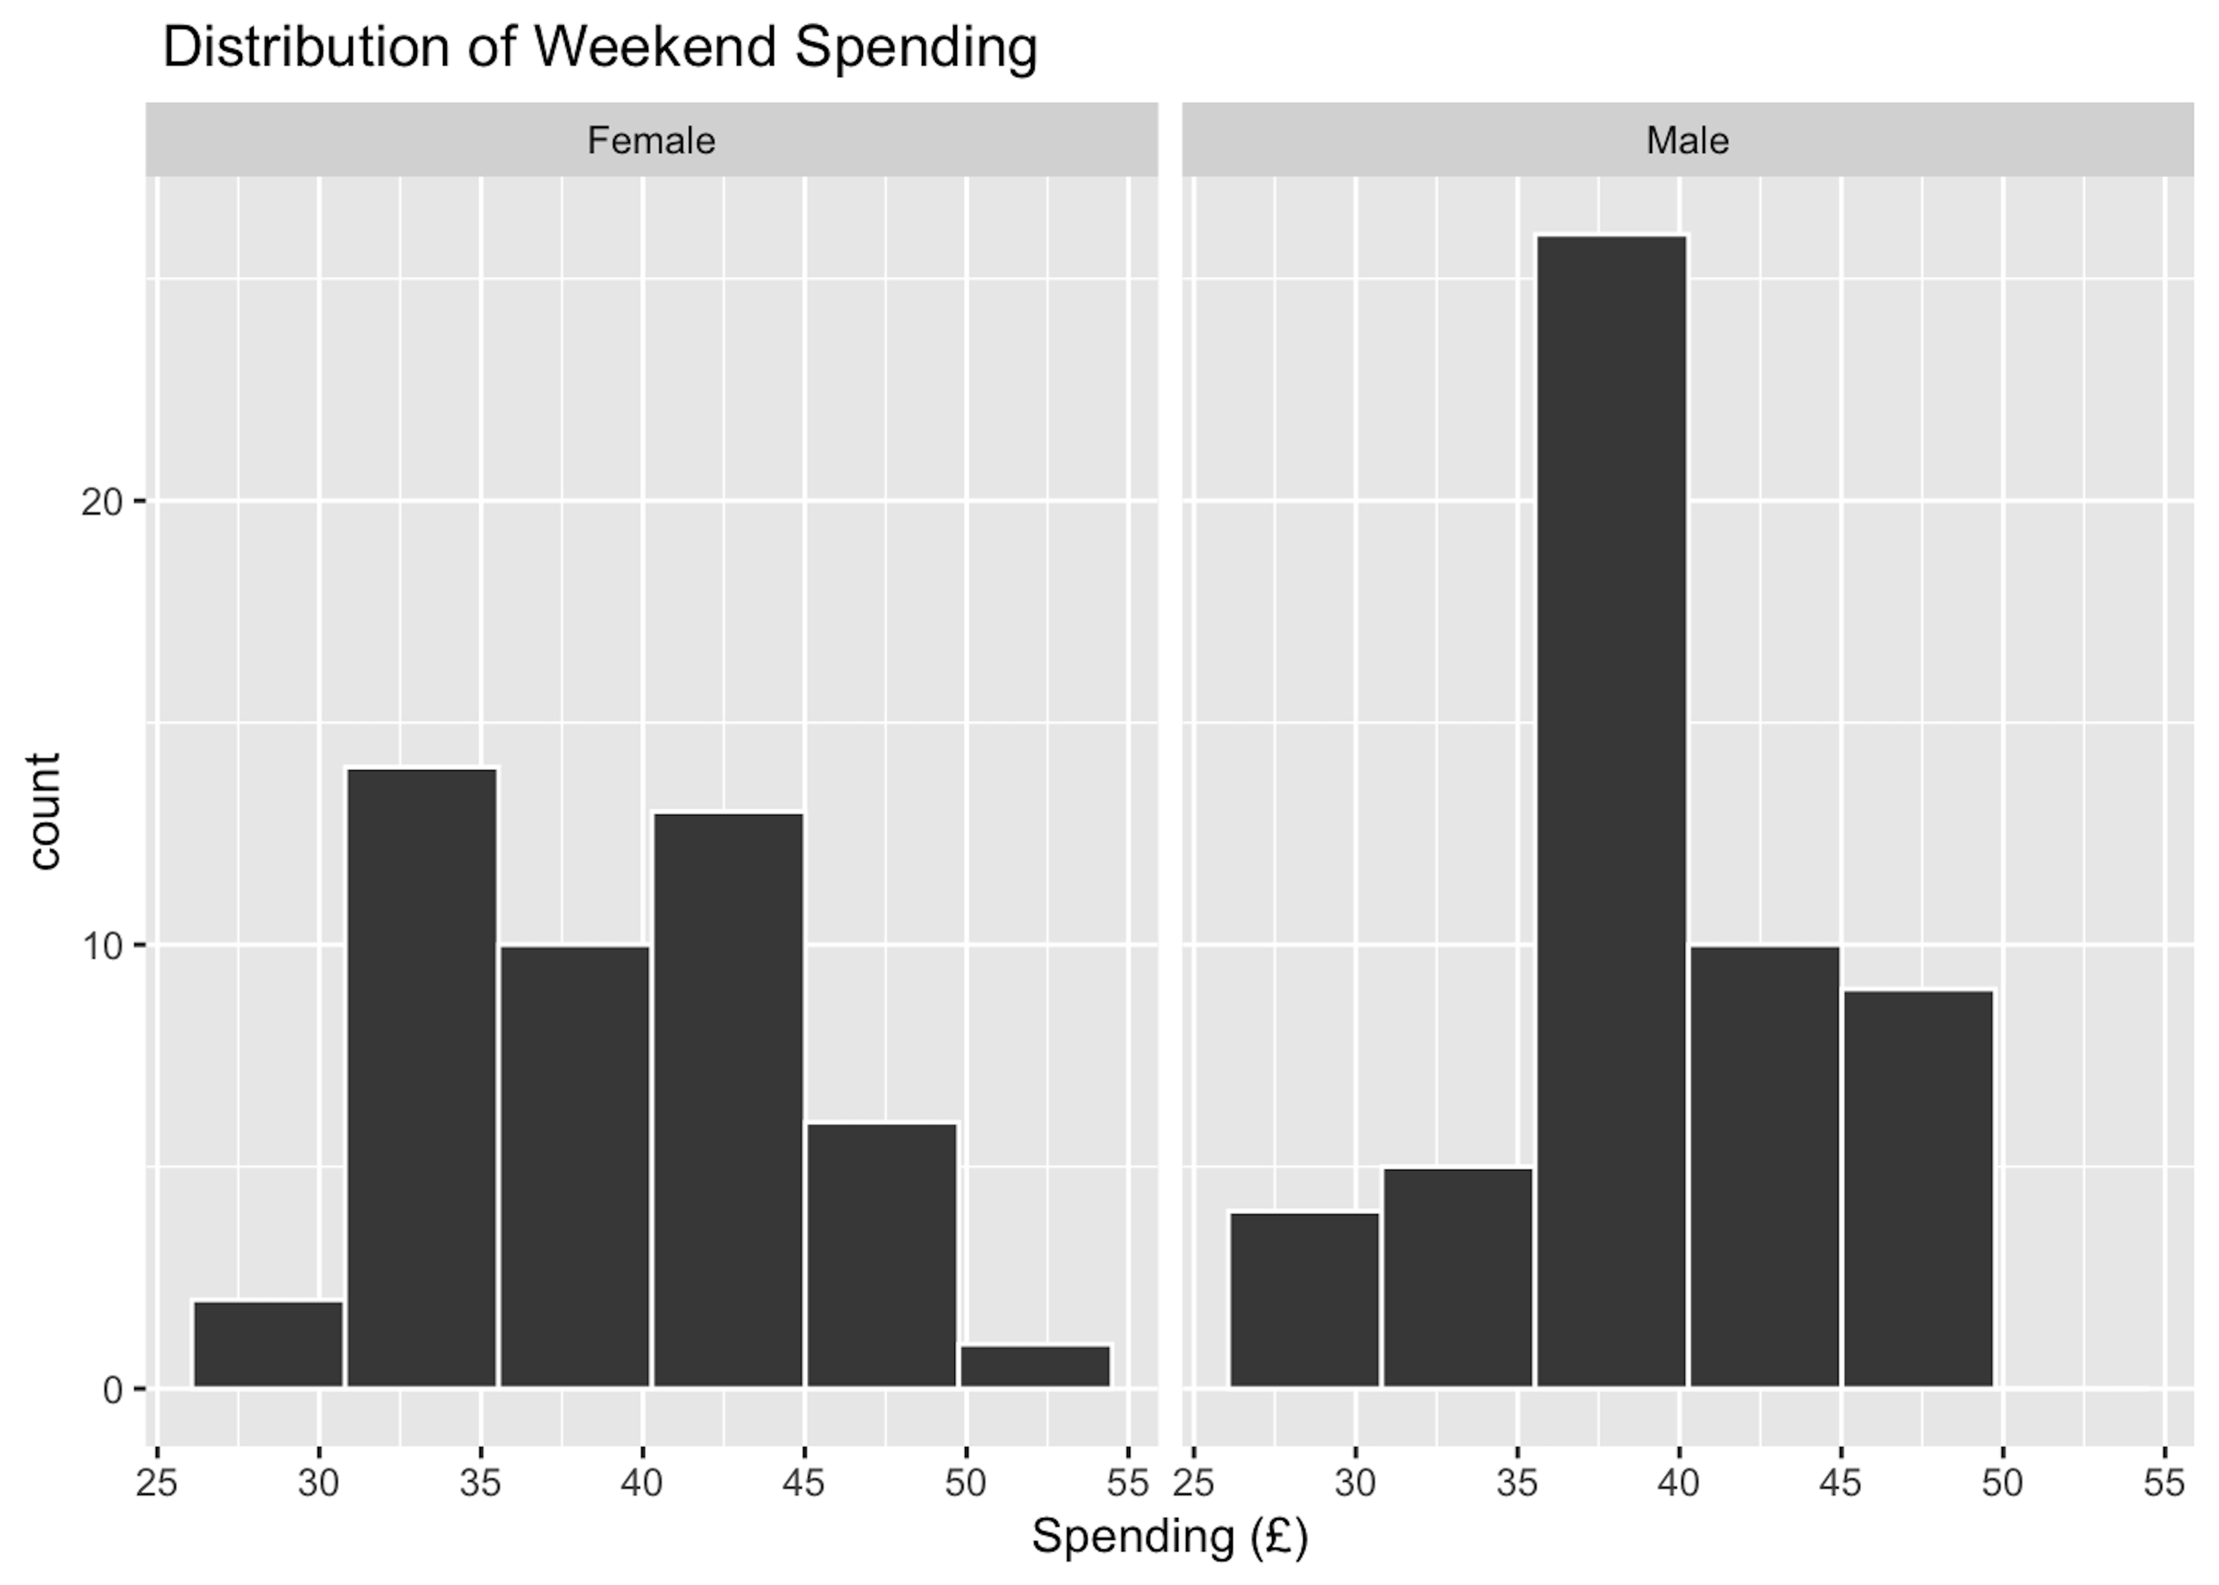
R Action (ggplot2)
library(ggplot2)
library(haven)
dat_spending <- read_sav("/Users/ahmaddaryanto/OneDrive - Lancaster University/dataspss/spending.sav")
p <- ggplot(dat_spending, aes(amount)) +
geom_histogram(bins = 6,
color="white",
fill="gray28") +
facet_wrap(~ gender, ncol = 2) +
labs(x="Spending (£)", title = " Distribution of Weekend Spending ")
p

Slide 19
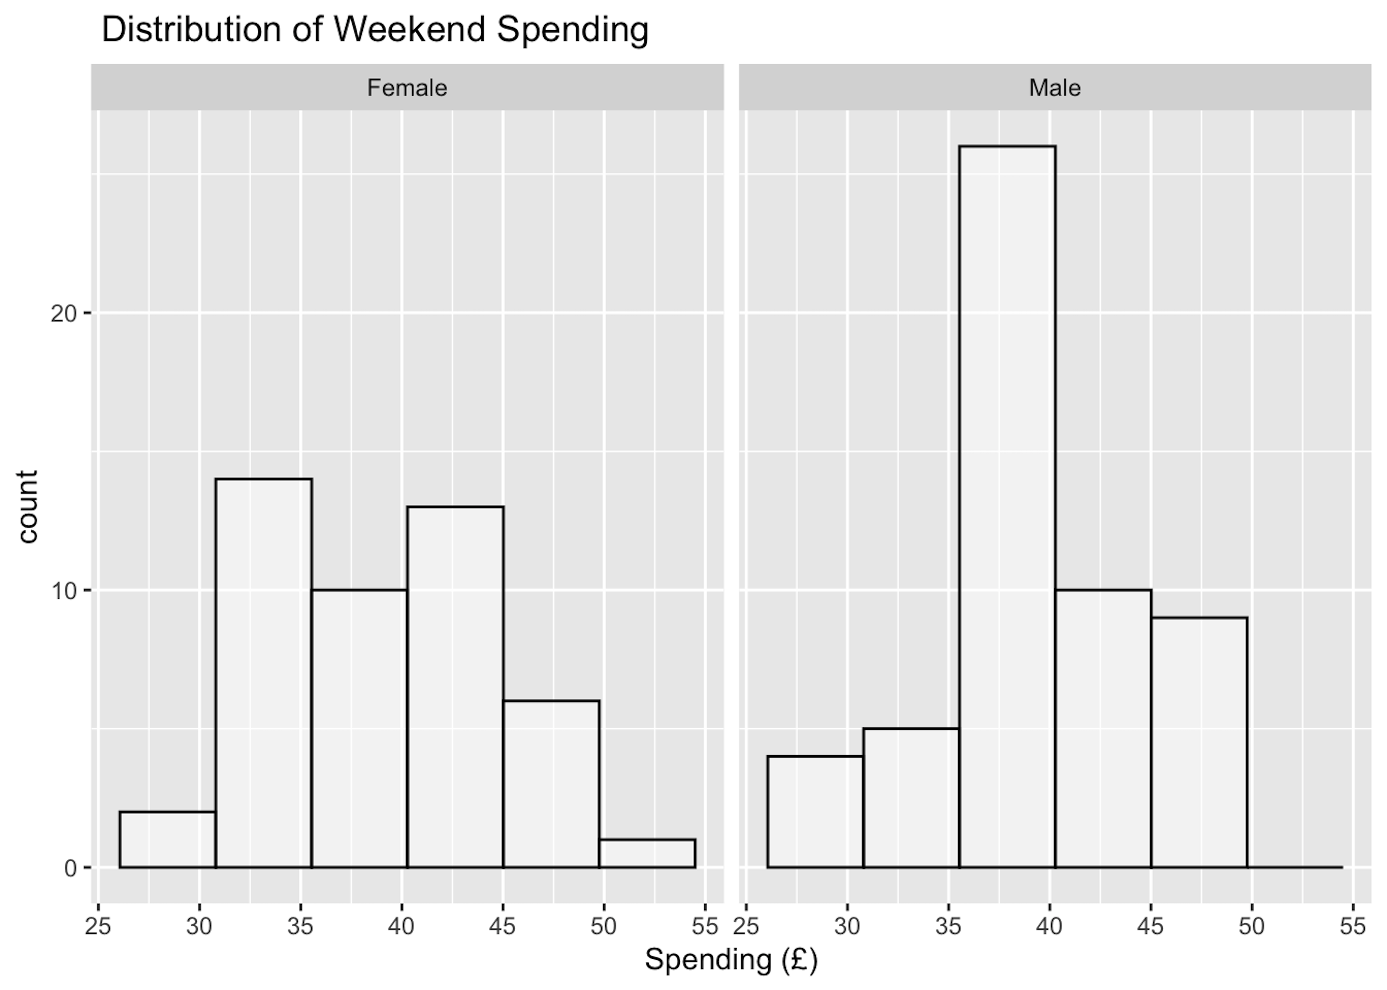
R Action (ggpubr)
library(ggpubr)
dat_spending <- read_sav("/Users/ahmaddaryanto/OneDrive - Lancaster University/dataspss/spending.sav")
p <- gghistogram(dat_spending,
x="amount",
bins=6,
color="black",
fill="white",
facet.by = "gender",
xlab="Spending (£)",
title = " Distribution of Weekend Spending ") +
theme_grey()
p

Slide 20
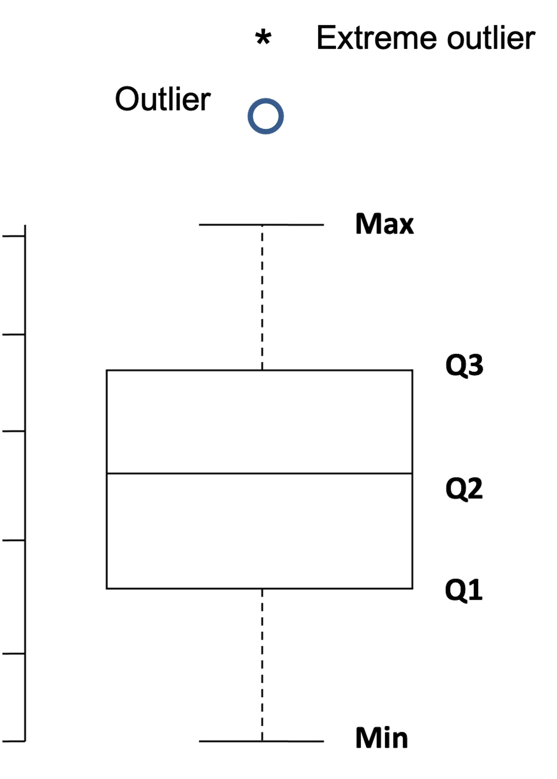
Boxplot
You have this data: 8, 9, 6, 7, 5, 4, 1, 2, 16, 3
Reordering: 1, 2, 3, 4, 5, 6, 7, 8, 9, 16
Q1 = 3, Q2 = 5.5, Q3 = 8
IQR = Q3 - Q1 = 5
Outer fence:
Upper fence: Q3 + 1.5*IQR = 8 + 1.5*5 = 15.5
Lower fence: Q1 - 1.5*IQR = 3 - 1.5*5 = -4.5
Therefore 16 is an outlier because 16 is above the upper fence.
Min = 1, max = 9. Min and max are the lowest and highest value that are not an outlier.

Slide 21
SPSS Action
EXAMINE VARIABLES=order
/COMPARE VARIABLE
/PLOT=BOXPLOT
/STATISTICS=NONE
/NOTOTAL
/MISSING=LISTWISE.

Slide 22
R Action
# locate the row
which_case <- which(dat %in% c(detected_outlier))
# show the row
which_case
# create boxplot
boxplot(dat,
ylab = "Value",
main = "Boxplot"
)
mtext(paste("Outlier: ", paste(detected_outlier, collapse = ", ")))
library(tidyverse)
# record our data
dat <- c(8, 9, 6, 7, 5, 4, 1, 2, 16, 3)
detected_outlier <- boxplot.stats(dat)$out
# view
head(dat)
# show outlier
detected_outlier
# use which() to locate row that corresponds with the outlier

Slide 24
geom_boxplot()
library(tidyverse)
library(haven)
dat <- as_tibble(c(8, 9, 6, 7, 5, 4, 1, 2, 16, 3))
p <- ggplot(dat, aes(y=value)) +
geom_boxplot(outlier.shape = 1)+
labs(y=" Value")
p
Setting aes(x=value) will return a horizontal boxplot.
The expression outlier.shape = "1" marked an outlier with a blank-circle shaped.

Slide 25
ggboxplot()
library(ggpubr)
ggboxplot(dat, y="value", orientation = "vertical", outlier.shape = 1)+
theme_grey()

